Slide 1

Chapter 23
Process-to-Process Delivery:
UDP, TCP, and SCTP
23.<number>
Copyright © The McGraw-Hill Companies, Inc. Permission required for reproduction or display.

Slide 2
23-1 PROCESS-TO-PROCESS DELIVERY
The transport layer is responsible for process-to-process delivery—the delivery of a packet, part of a message, from one process to another. Two processes communicate in a client/server relationship, as we will see later.
Topics discussed in this section:
Client/Server Paradigm
Multiplexing and Demultiplexing
Connectionless Versus Connection-Oriented Service
Reliable Versus Unreliable
Three Protocols
23.<number>

Slide 3

Note
The transport layer is responsible for process-to-process delivery.
23.<number>

Slide 4

Figure 23.1 Types of data deliveries
23.<number>

Slide 5

Figure 23.2 Port numbers
23.<number>

Slide 6

Figure 23.3 IP addresses versus port numbers
23.<number>

Slide 7

Figure 23.4 IANA ranges
23.<number>

Slide 8

Figure 23.5 Socket address
23.<number>

Slide 9

Figure 23.6 Multiplexing and demultiplexing
23.<number>

Slide 10

Figure 23.7 Error control
23.<number>

Slide 11

Figure 23.8 Position of UDP, TCP, and SCTP in TCP/IP suite
23.<number>

Slide 12
23-2 USER DATAGRAM PROTOCOL (UDP)
The User Datagram Protocol (UDP) is called a connectionless, unreliable transport protocol. It does not add anything to the services of IP except to provide process-to-process communication instead of host-to-host communication.
Topics discussed in this section:
Well-Known Ports for UDP
User Datagram
Checksum
UDP Operation
Use of UDP
23.<number>

Slide 13


Table 23.1 Well-known ports used with UDP
23.<number>

Slide 14

Figure 23.9 User datagram format
23.<number>

Slide 15
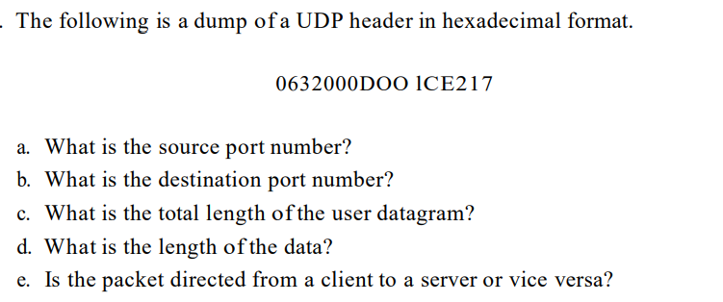
Problem
23.<number>

Slide 16
Note
UDP length
= IP length – IP header’s length
23.<number>

Slide 17
Use of UDP
UDP is suitable for a process that requires simple request-response communication with little concern for flow and error control. It is not usually used for a process that needs to send bulk data.
UDP is suitable for a process with internal flow and error control mechanisms.
UDP is a suitable transport protocol for multicasting. Multicasting capability is embedded in the UDP software but not in the TCP software.
UDP is used for management processes such as SNMP
UDP is used for some route updating protocols such as Routing Information Protocol.
23.<number>

Slide 18
23-3 TCP
TCP is a connection-oriented protocol; it creates a virtual connection between two TCPs to send data. In addition, TCP uses flow and error control mechanisms at the transport level.
Topics discussed in this section:
TCP Services
TCP Features
Segment
A TCP Connection
Flow Control
Error Control
23.<number>

Slide 19

Table 23.2 Well-known ports used by TCP
23.<number>

Slide 20

Figure 23.13 Stream delivery
23.<number>

Slide 21

Figure 23.14 Sending and receiving buffers
23.<number>

Slide 22

Figure 23.15 TCP segments
23.<number>

Slide 23
Note
The bytes of data being transferred in each connection are numbered by TCP.
The numbering starts with a randomly generated number.
23.<number>

Slide 24
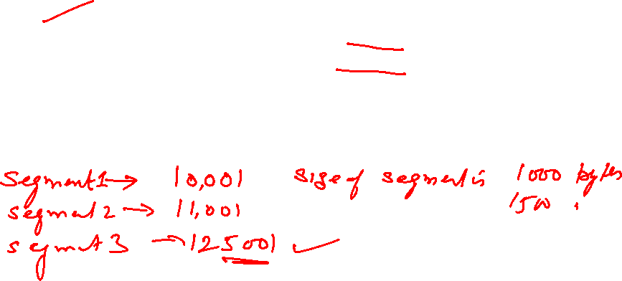

Example 23.3
The following shows the sequence number for each segment:
23.<number>

Slide 25
Note
The value in the sequence number field of a segment defines the
number of the first data byte
contained in that segment.
23.<number>

Slide 26
Note
The value of the acknowledgment field in a segment defines
the number of the next byte a party expects to receive.
The acknowledgment number is cumulative.
23.<number>

Slide 27

Figure 23.16 TCP segment format
23.<number>

Slide 28

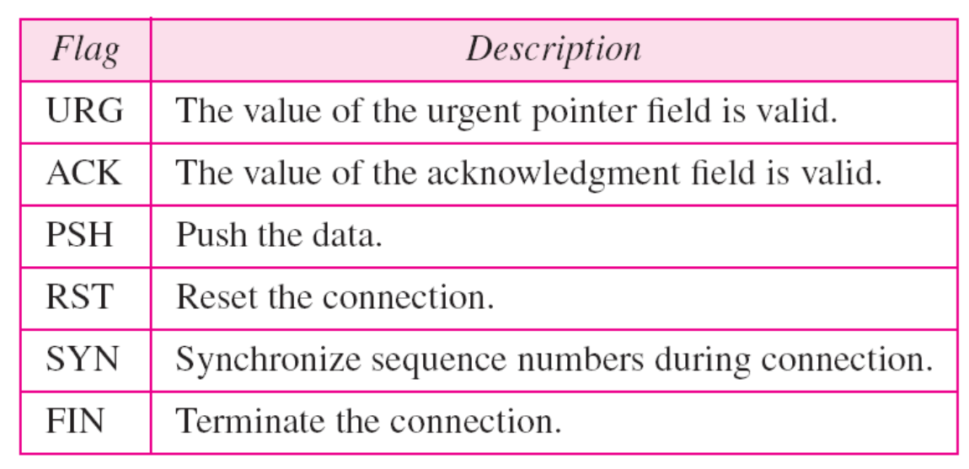
Figure 23.17 Control field
23.<number>

Slide 29
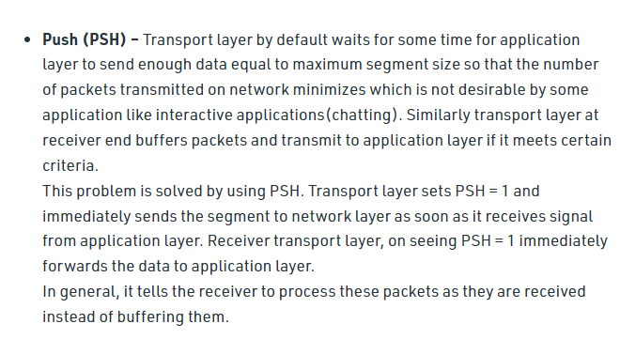
23.<number>

Slide 30
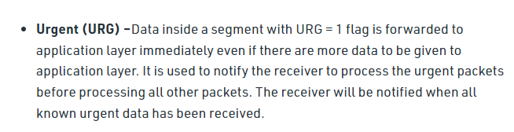
23.<number>

Slide 31
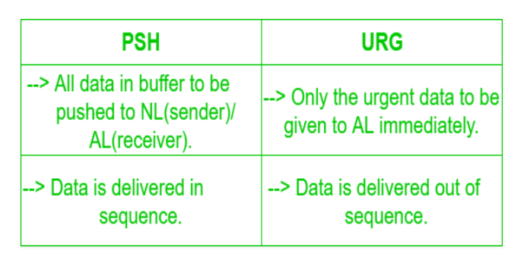
23.<number>

Slide 32
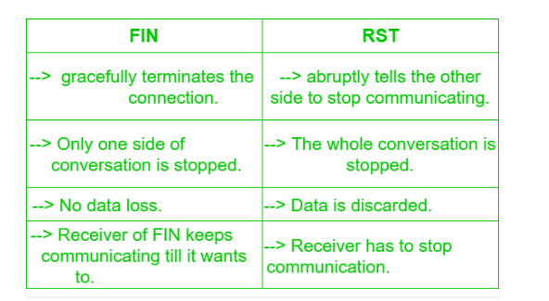
23.<number>

Slide 34


Slide 37
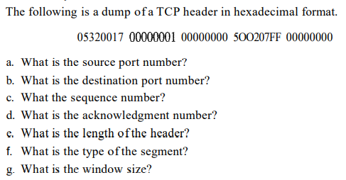
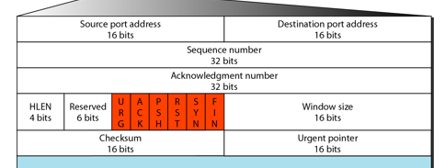

Slide 38
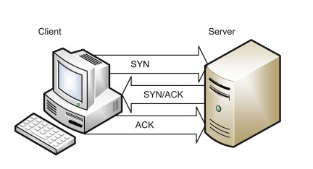
Three way handshake in TCP
23.<number>

Slide 39

Connection establishment using three-way handshaking
23.<number>

Slide 40
Note
A SYN segment cannot carry data, but it consumes one sequence number.
A SYN + ACK segment cannot
carry data, but does consume one
sequence number.
An ACK segment, if carrying no data, consumes no sequence number.
23.<number>

Slide 41

Data transfer
23.<number>

Slide 42

Connection termination using three-way handshaking
23.<number>

